Slide 1

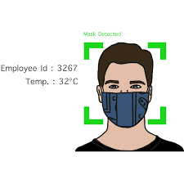
Face Mask Detection
Minor Project
Submitted by-
Rishu kumar
2018IMG-048

Slide 2
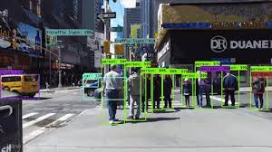
Object Detection
Object detection is a computer vision and image processing technique that helps us to recognize and locate objects in an image or video.
Object detection can be used to detect objects in a image/video and determine and track their exact locations and labels them.
It has application in numerous field of image processing, including picture retrieval or recognition, security, observation, and machine investigation.
Here we will see one of its application as Face Mask Detector.

Slide 3

The need of Face Mask detector
The mankind is facing COVID-19 pandemic that is the most severe event which has startled the world since the year 2020 begin. It is affecting the health and lives of masses, COVID-19 has called for harsh actions to be taken by the government in order to prevent the spread of the disease. Face masks has become one of the most important personal protective equipment.
A face mask detector system can be implemented to check if people are following the safety principle made by the government .
The two steps that need to be implemented to spot the presence of a mask on the face is to first detect the face and then detect masks on those faces.

Slide 4

Now let see how does Face Mask detection actually works
Image Processing
Face Detection
Face Mask Detection
Feature Extraction

Slide 5
Image Processing
Image processing is a method to perform some operations on an image, that helps us to get enhanced image or to extract some useful information from it.
In python we have OpenCV package which will help us to read the image and converts it into array and returns it.
Images are group of RGB colour format that means red ,green and blue. A human see an image with some entity , shape or structure in it , but on the other hand a computer sees it an array with colour values ranging from 0 to 255.
Thus it become easy for us to implement any algorithm on this array of RGB with the help of Numpy library of python.

Slide 6
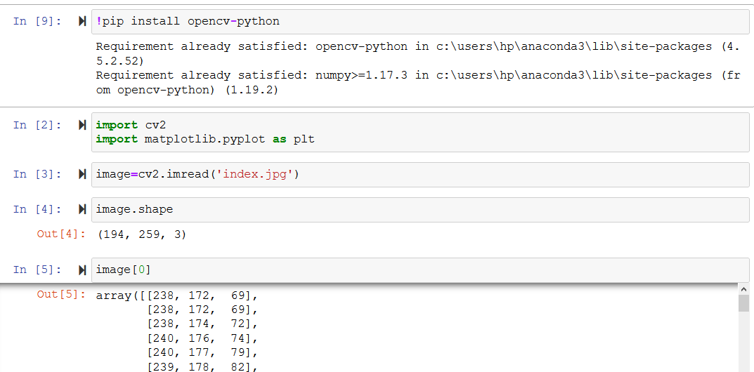
Steps to perform Image Processing
Step1: Load images using python .In python we have OpenCV which will help us to do this. It reads the image and converts it into an array
Step2:Convert the images into an array using OpenCV
Step3: And Then we can apply any algorithm on that array

Slide 7

OpenCV- A python library
Before moving on to Face detection step let us know few points about OpenCV.
Open Source Computer Vision Library or OpenCV is an open source computer vision and a python library.
OpenCV has Python, Java, C++ and MATLAB interfaces and supports most of the reputed OS like Windows, Linux, Mac etc.
Its help to load images in Python and transforms them into an array.
Every index of array represents RGB(Red, Green, Blue) colour pixel ranging from 0 to 255.

Slide 8
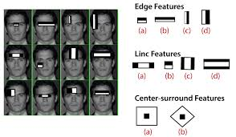
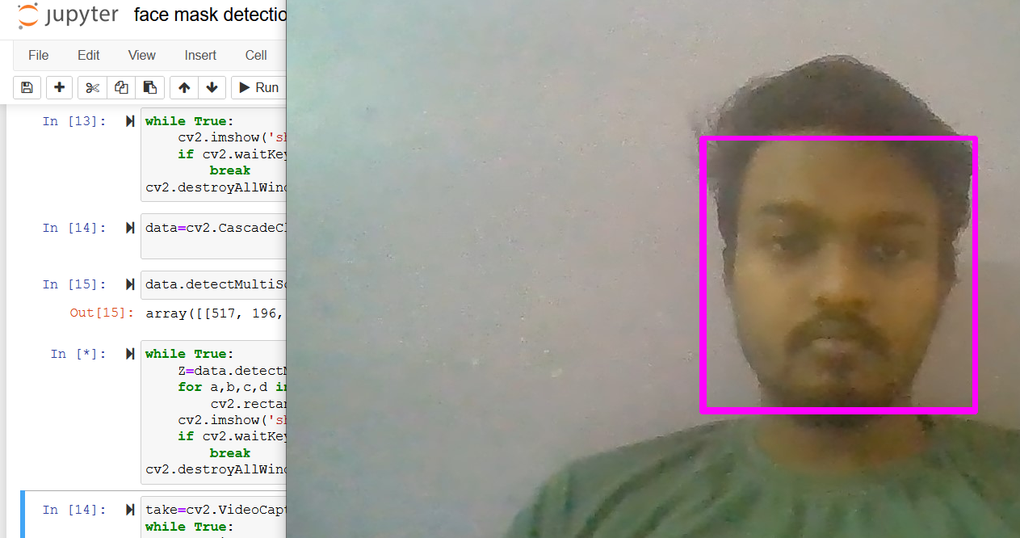
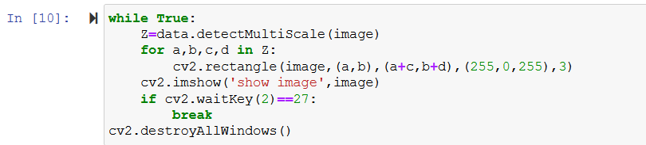
Face detection and feature extraction using OpenCV
There are four stages of face detection of algorithm , they are---
1) features selection 2)Integral Image
3)Adaboost 4)Cascading Classifiers
We have a XML file(Haar Cascade) which helps to detect face from any image/ video.
The below code detect face from image by drawing a rectangle.
Feature extraction
Face detection

Slide 9
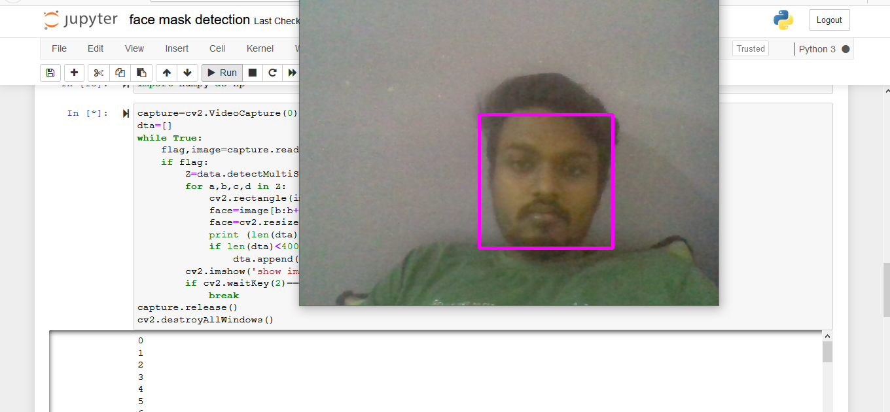
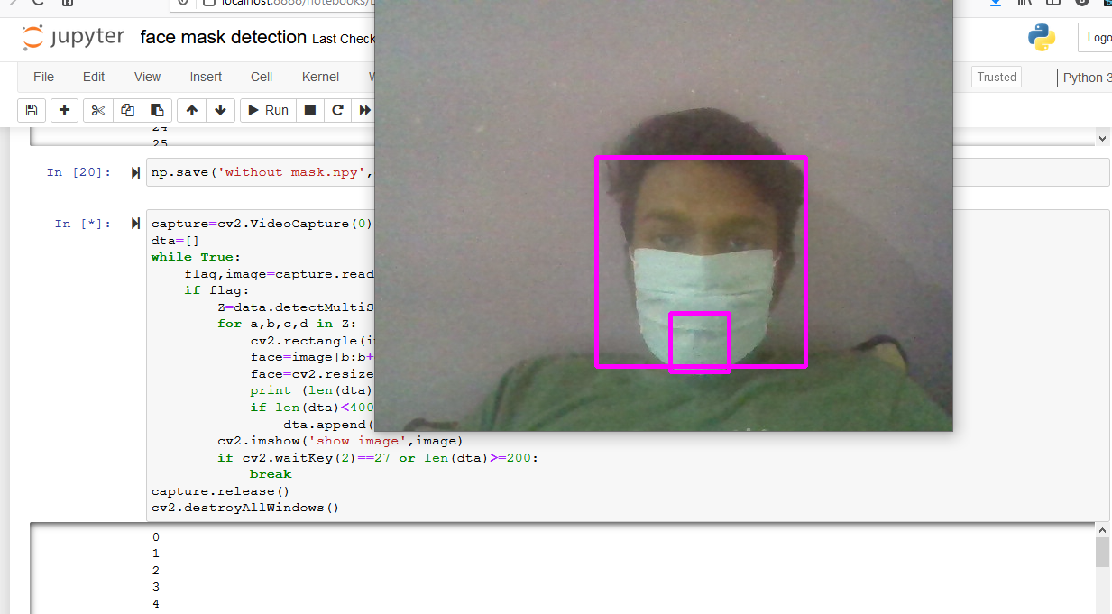
Mask detection on a face
After the detection of face next steps of detecting face mask are---
Step1:Collect face data with and without mask with the help of camera.
Step2:Train the data using SVM machine learning Algorithm.
Step3: Now we can do prediction on live data using our own Camera.
How to perform step 1—We need a lot of data in the form images of a person wearing a mask and not wearing a mask to implement this project. So we need to collect data and I am going to collect data using my own camera two time one without mask and the other time after wearing mask.
Collecting data without mask
Collecting data with mask

Slide 10
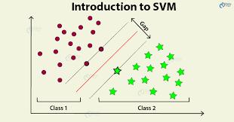
Support Vector Machine
Support vector machines (SVMs) are a set of supervised learning methods used for classification and regression.
There are various advantages of support vector machines ,they are------
It is Effective in high dimensional spaces.
It Uses a subset of training points in its decision function (called support vectors),
Thus this makes it memory efficient.
It has versatile nature that is- different Kernel functions can be specified for the decision function

Slide 11
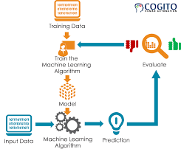
Training the data using SVM
Before training the data we import the necessary libraries and also load the data that we created in the previous step.
We then split the our data into training and test set with test size equal to 0.25.And apply SVM classifier to train our model on the training data set using the fit function.
Now Our model is trained and we can use it to detect face mask on our test data set or on live camera/video recording . The accuracy of our model is 98 %.

Slide 12
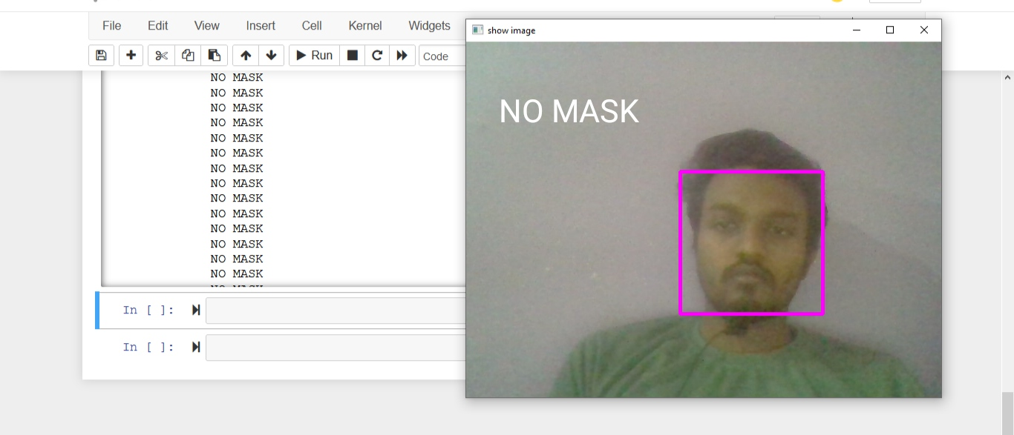
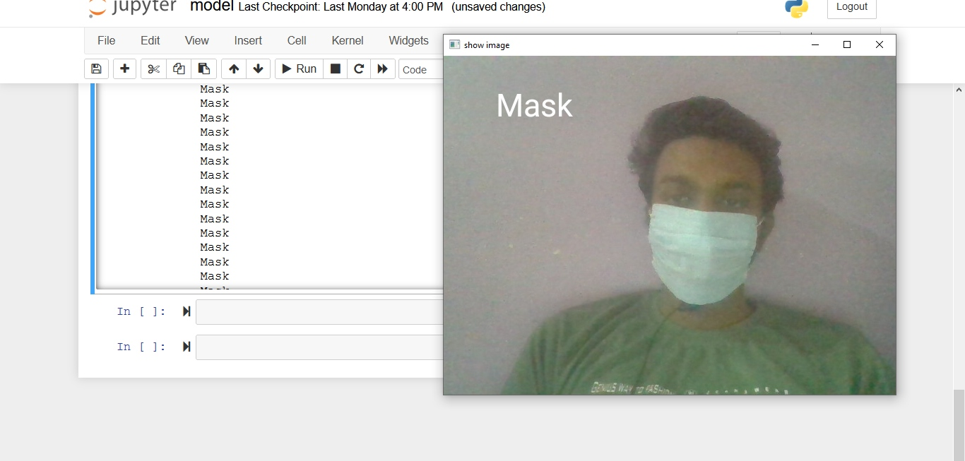
Step 3: Demo on Face Mask detection
As we can see in the right that when we are not wearing a mask the model detects no face mask and thus it says “NO MASK”.
Next ,when I put on my mask ,my model detect detects mask on my face and thus produces output “Mask”

Slide 13

Conclusion
To alleviate the spread of COVID-19 pandemic, strict measures must be taken. I have implemented a face mask detector using OpenCV and Support Vector Machine learning algorithm. I have collected two types of data/image first one was after wearing mask and other one was without wearing any mask .Then we performed our machine learning algorithm (SVM ) to detect face mask. The model was inferred on images and live video streams.
This face mask detector can be installed in many public places like shopping malls, airports and other heavy traffic places to monitor the public and to avoid the spread of the Corona Virus by inspecting who is following basic rules and who is not .
Thus it will helps us to fight against this pandemic.

Slide 14


